Slide 1
Date, Calendar, Math

Slide 2
java.util.Date
The class Date represents a specific instant in time, with millisecond precision.
Using:
Date now = new Date();

Slide 3
Date usage
Date now = new Date();
now.getTime();
now.after(anotherDate)
Returns the number of milliseconds since January 1, 1970, 00:00:00 GMT represented by this Date object.
Tests if this date is after the specified date.

Slide 4
DateFormat
Date now = new Date();
String s = DateFormat.getDateInstance(
DateFormat.SHORT,
Locale.US).format(now); // 3/13/13
String s = DateFormat.getDateInstance(
DateFormat.SHORT,
Locale.CANADA).format(now); // 13/03/13

Slide 5
java.util.Locale
Locale object represents a specific geographical, political, or cultural region.
Some operations require locales to perform they tasks in locale-sensitive manner.
Locale locale = new Locale(String language, String country);
Locale.getDefault();
Locale.US; // "en", "GB"

Slide 6
Setting Locale
java
-Duser.language=ru
-Duser.country=BY
SomeClass

Slide 7
?

Slide 8
java.util.Calendar
Calendar is an abstract class that provides methods for modifying and converting time instances

Slide 9
Calendar usage
Calendar c = Calendar.getInstance();
if(Calendar.SUNDAY == c.getFirstDayOfWeek())
System.out.println("Sunday is the first day of the week");
c.set(Calendar.YEAR, 2000);
c.add(Calendar.MONTH, 1);
c.get(Calendar.DAY_OF_MONTH);
c.get(Calendar.DAY_OF_YEAR);
Date d2 = c.getTime();
System.out.println("new date " + d2.toString());

Slide 10
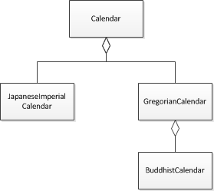
Calendar implementations

Slide 11
GregorianCalendar
Provides the standard calendar system used by most of the world.
Calendar calendar = GregorianCalendar.getInstance();
Calendar.getInstance()
- will also return GregorianCalendar for our current locale

Slide 12
?

Slide 13
Math
here

